Slide 1
January 16, 2018
Turn in Vox Border Video Charts
Canadian Provinces Map Quiz
Forms of Govt. Notes
HW: Read pgs. 274-277 and Gerrymandering Article

Slide 2
Types of Governments
Democracy: citizens elect leaders
Autocracy: run by one ruler and their interests
Anocracy: blend of the two
Failed State: very weak govt. and economy

Slide 3
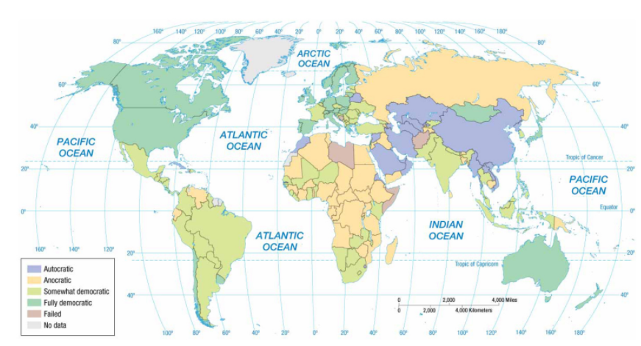

Slide 4
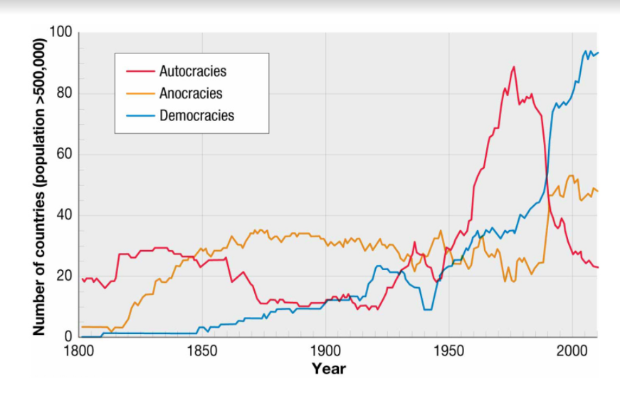

Slide 5
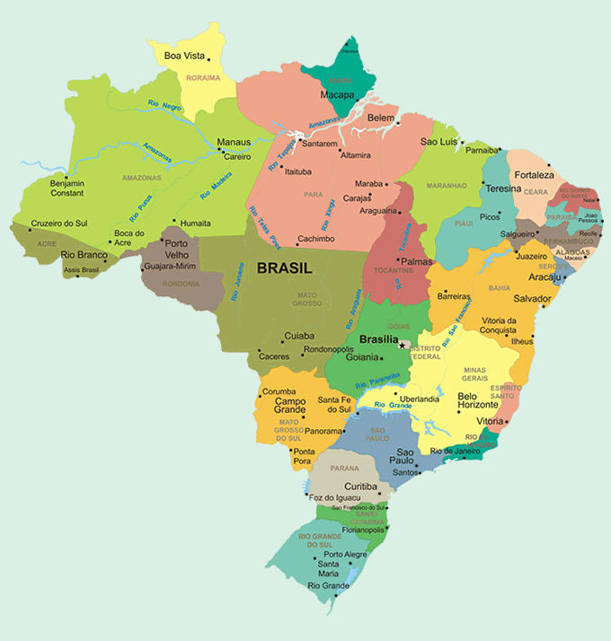
Federal vs. unitary
Federal – a government where the state is organized into territories, which have control over government policies and funds.
Best in diverse states
Works well in large states

Slide 6
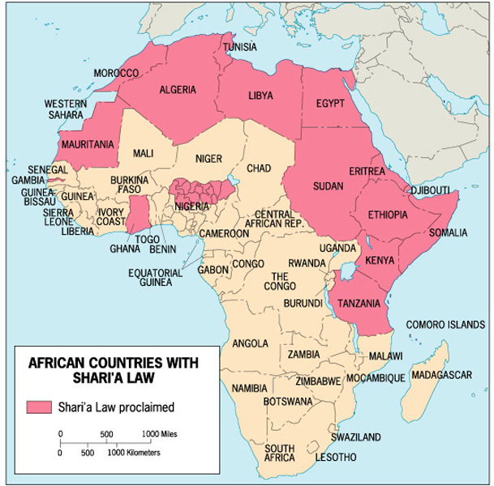
Federal state: Nigeria
Very diverse
Northern provinces have Shari’a Law

Slide 7
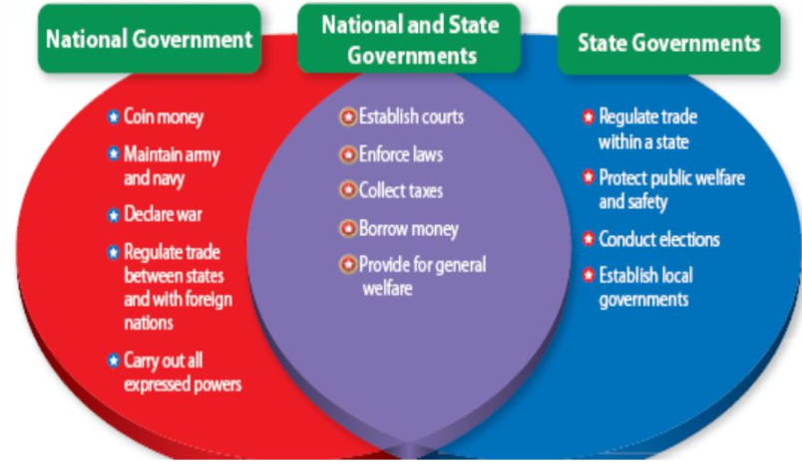
Federal state: usa

Slide 8
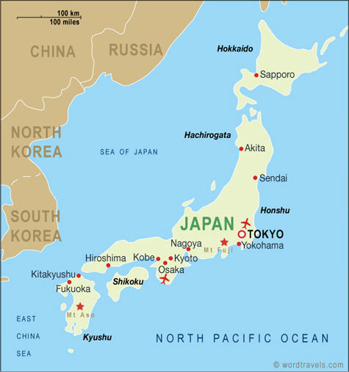
Federal vs. unitary
Unitary – highly centralized government where the capital city serves as a focus of power.
Best in nation-states
Requires good communication and control
Often centrally located capital
Ex: many European countries

Slide 9
Federal vs. unitary
China: unitary
Belgium: federal

Slide 10
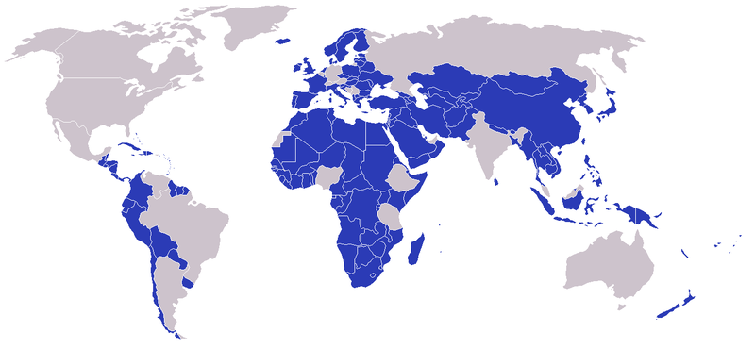
Unitary: blue Federal: gray

Slide 12
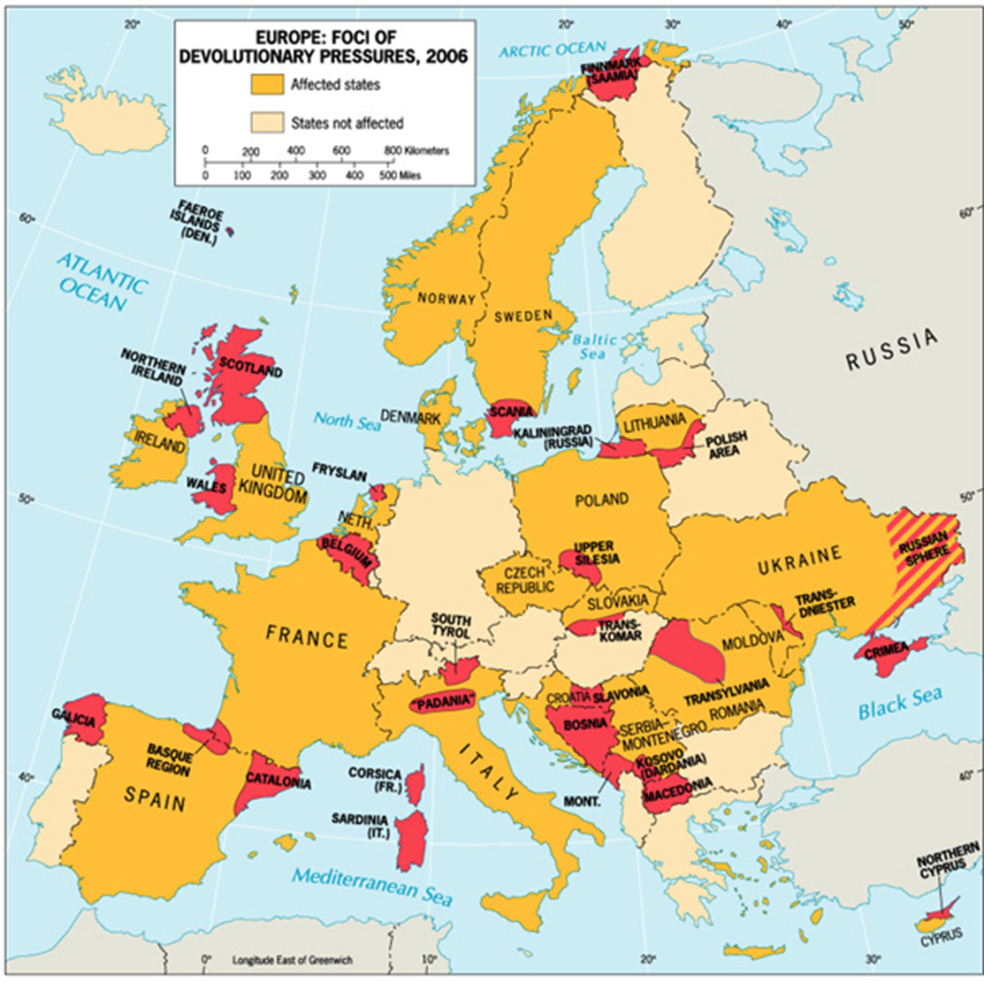
Devolution
Movement of power from central to regional govts.
Caused by:
Ethno-cultural movements
Ex: Czechoslovakia
Economic factors
Ex: Catalonia
Spatial forces
Ex: Hawaii

Slide 13
Electoral geography
In the United States:
territorial representation: a system wherein each representative is elected from a territorially defined district
reapportionment: the process by which districts are moved according to population shifts, so that each district encompasses approximately the same number of people
redistricting: the redrawing of congressional districts following reapportionment

Slide 14
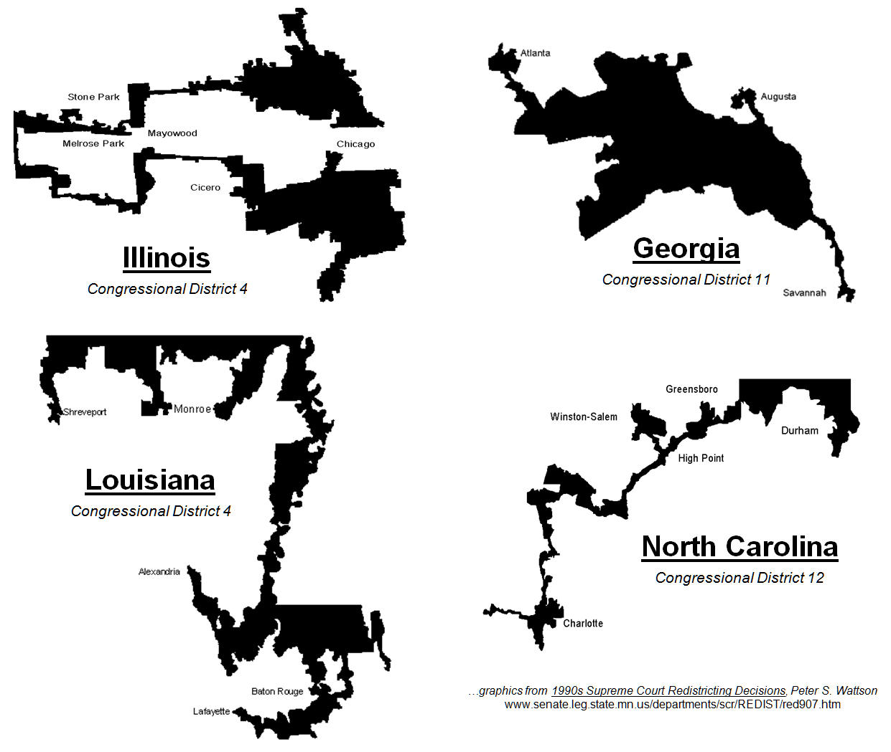
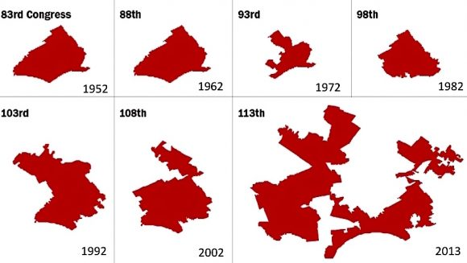
Gerrymandering
Drawing districts to favor one political party
Types of Gerrymandering
Stacked Vote
Wasted Vote
Excess Vote

Slide 16
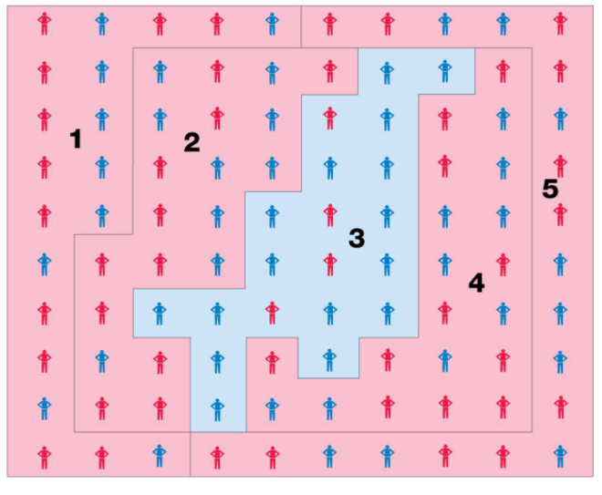
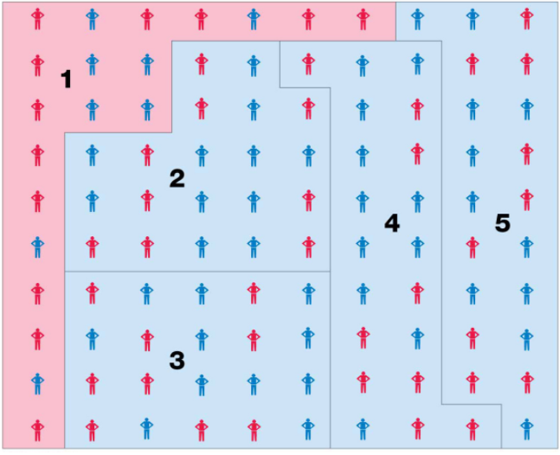
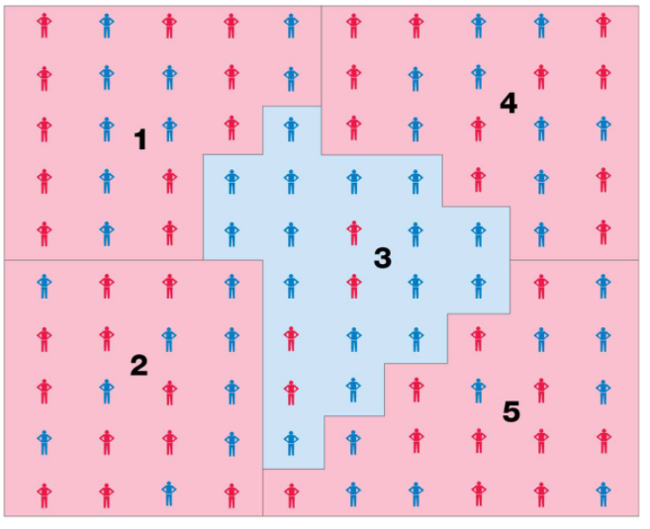

Slide 17
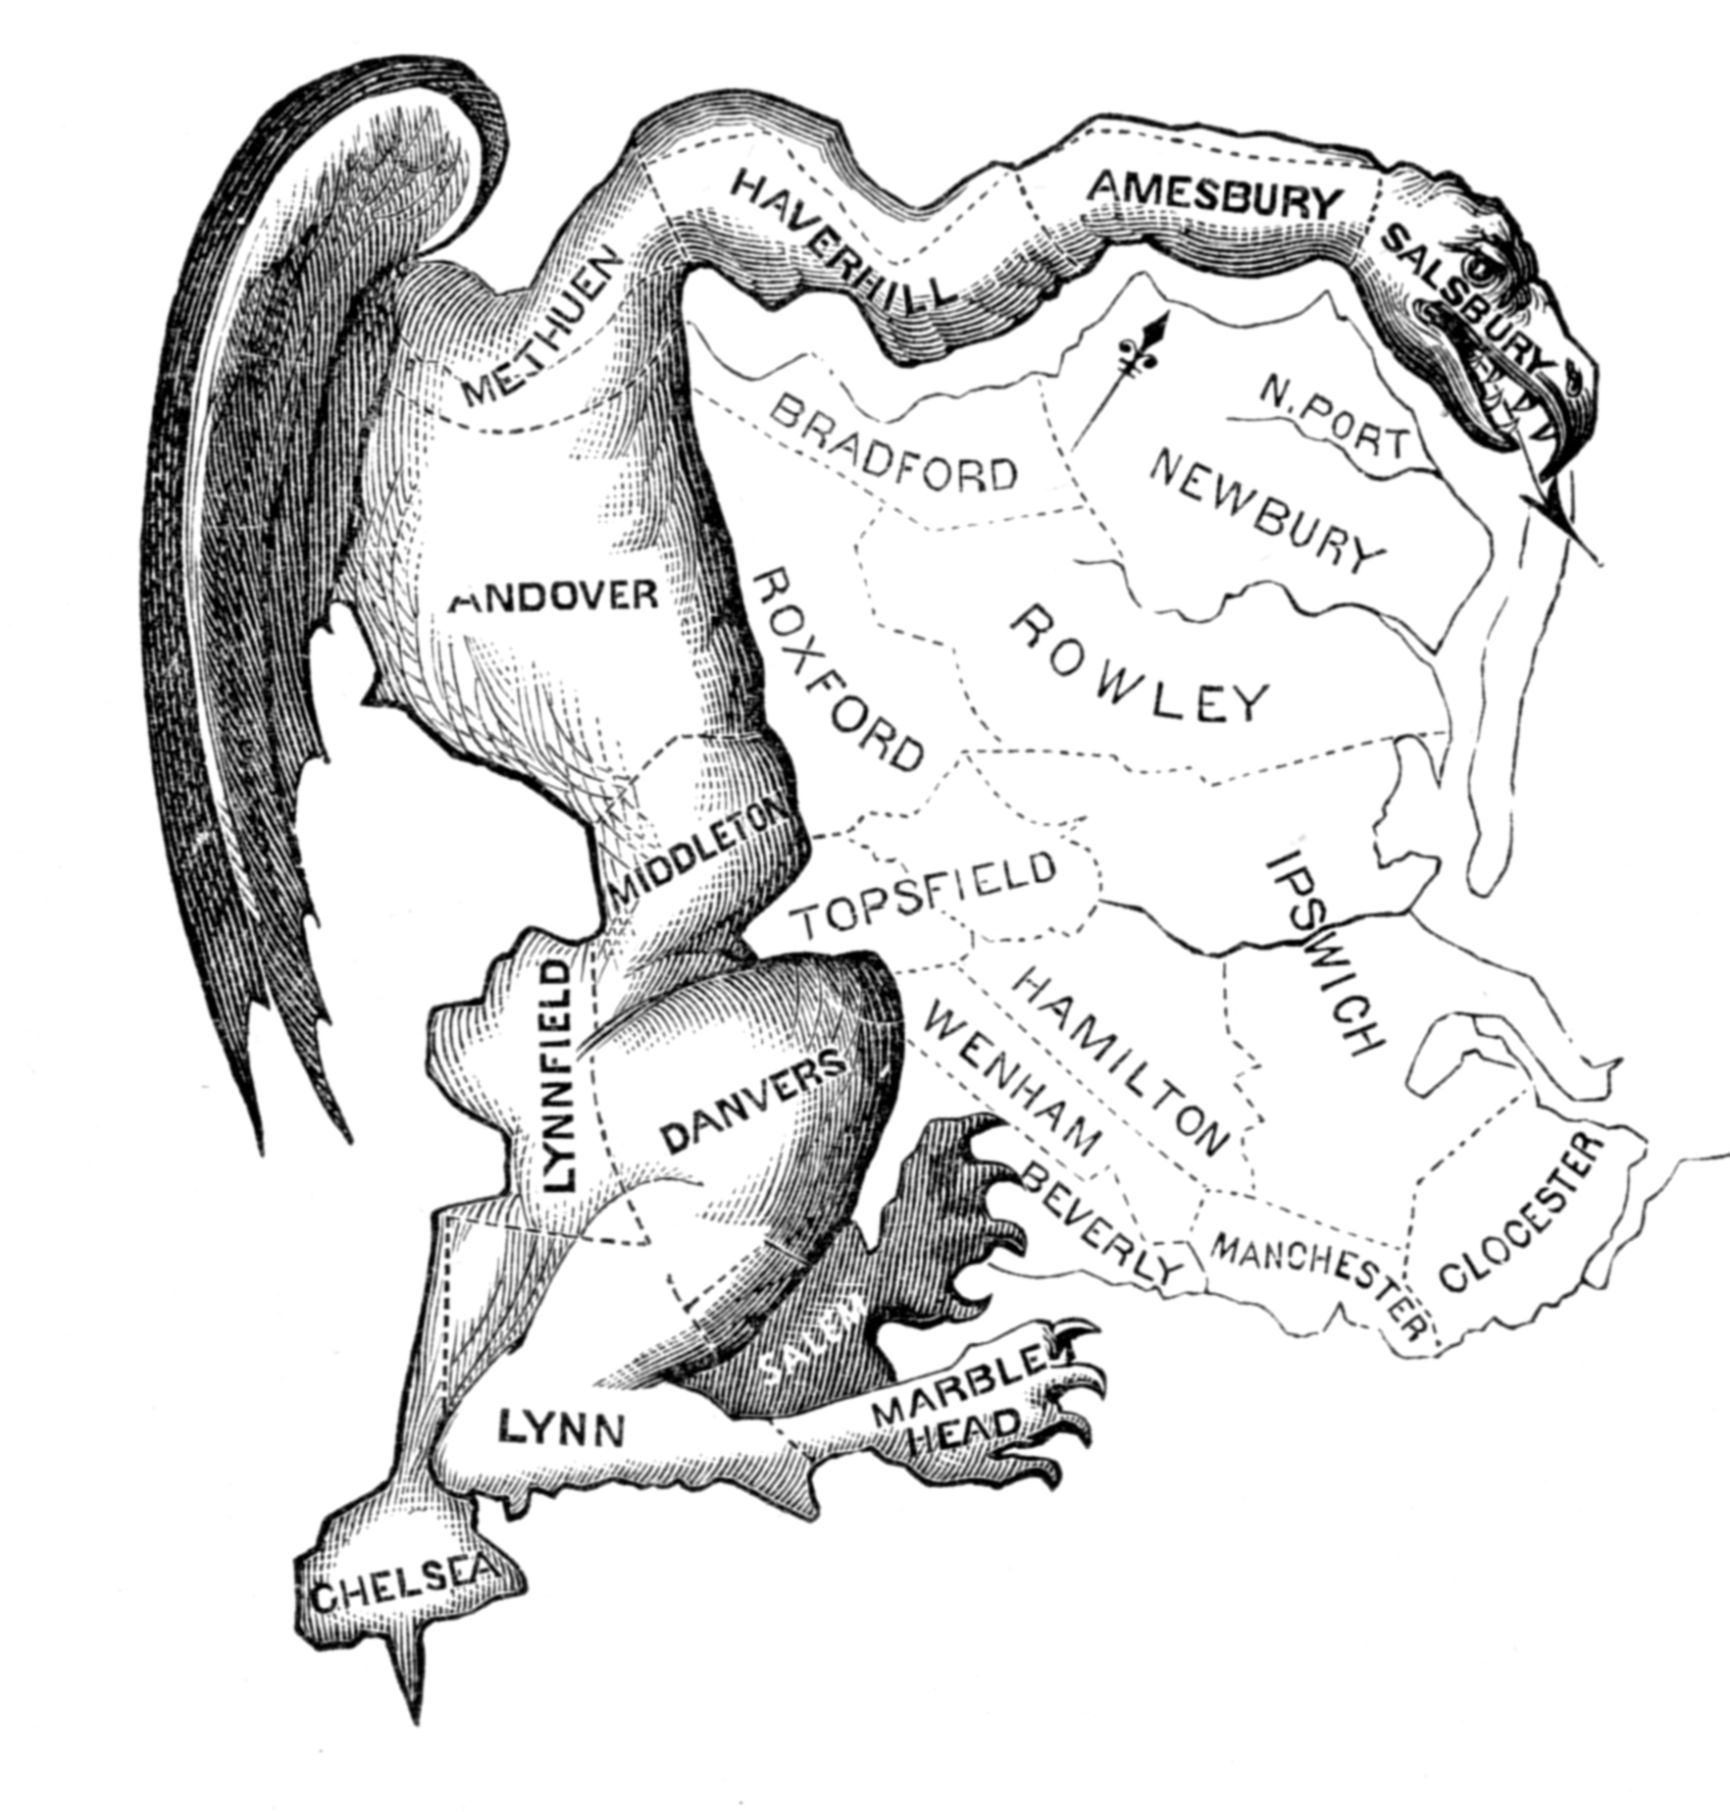
http://ed.ted.com/lessons/gerrymandering-how-drawing-jagged-lines-can-impact-an-election-christina-greer

