Slide 1
Get out stuff for notes Trends in urbanization hw: vocab due Friday
APRIL 17, 2018

Slide 2
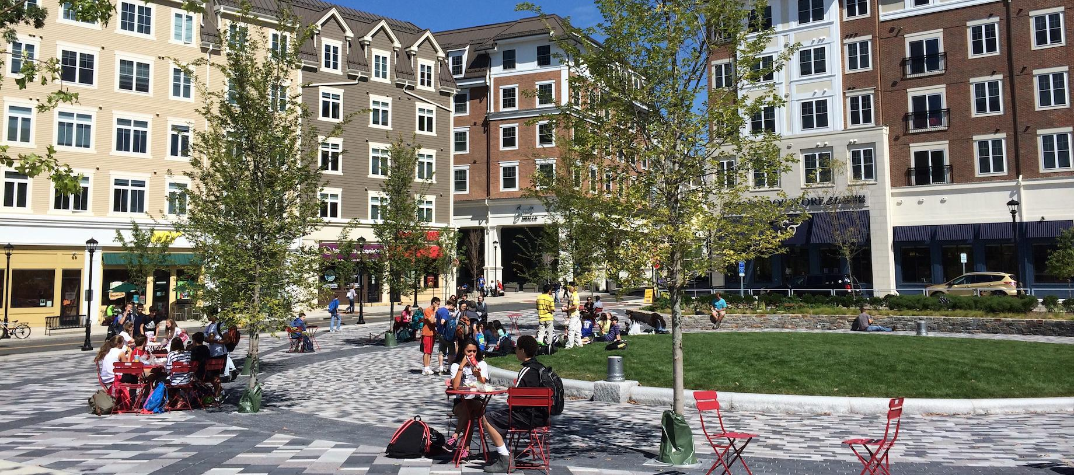
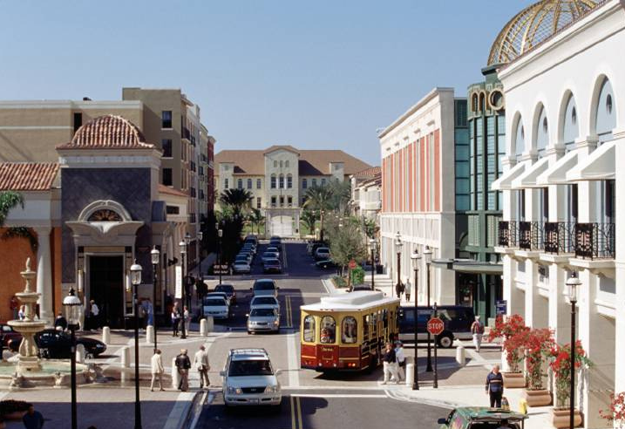
New urbanism
https://www.youtube.com/watch?v=XoVXoB6x3vM
Creation of more walkable neighborhoods
Mixed use buildings
Mixed income housing
Garages and alleyways in back
Sustainability
Sense of community

Slide 3
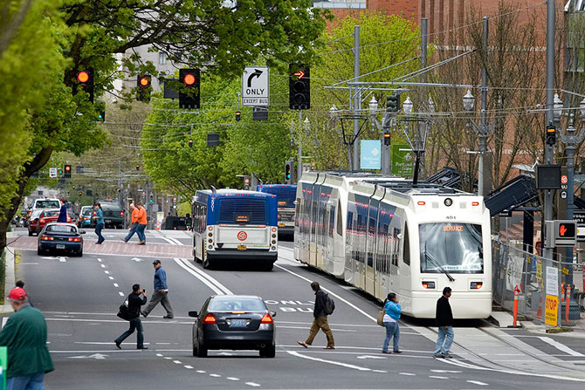
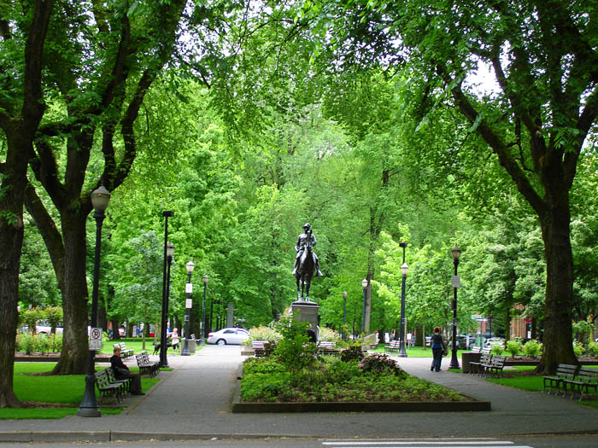
Slow growth and smart growth

Slide 4
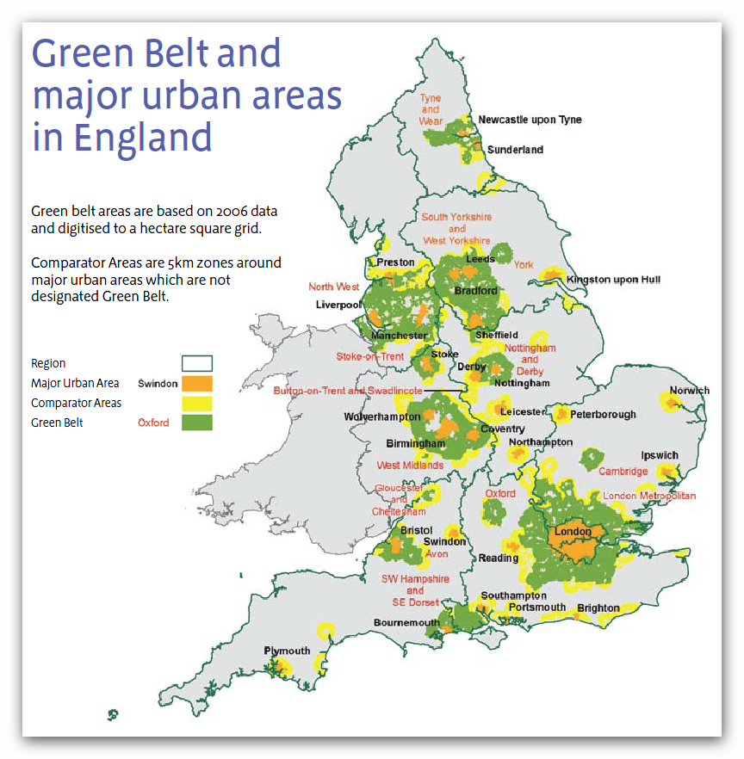
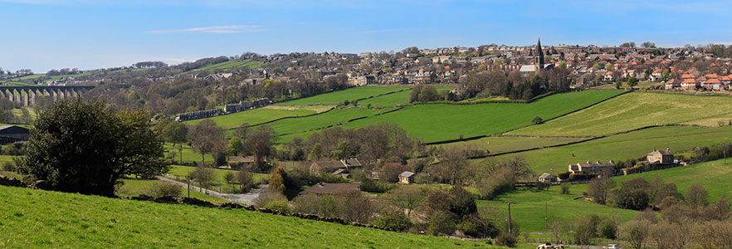
Green belts
Area of green space around cities
Limit sprawl

Slide 5
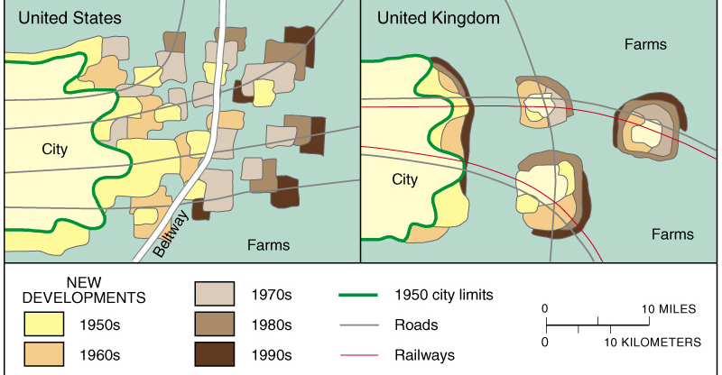
Europe versus U.S. Cities: Sprawl

Slide 6
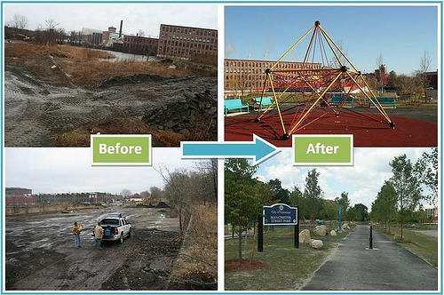
Brownfield
Former industrial land
Railroad tracks
Factories
Atlanta Beltline

Slide 7
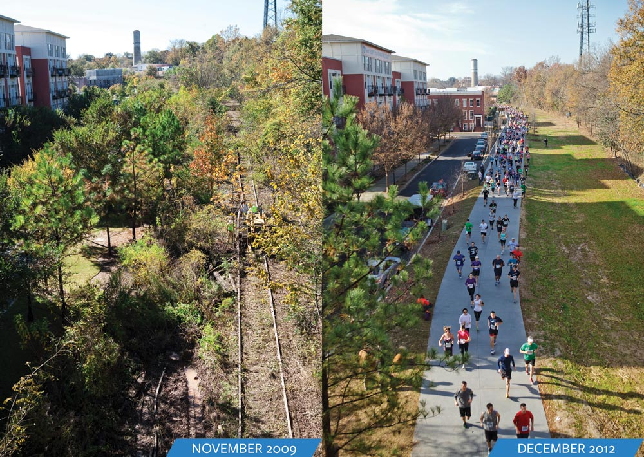
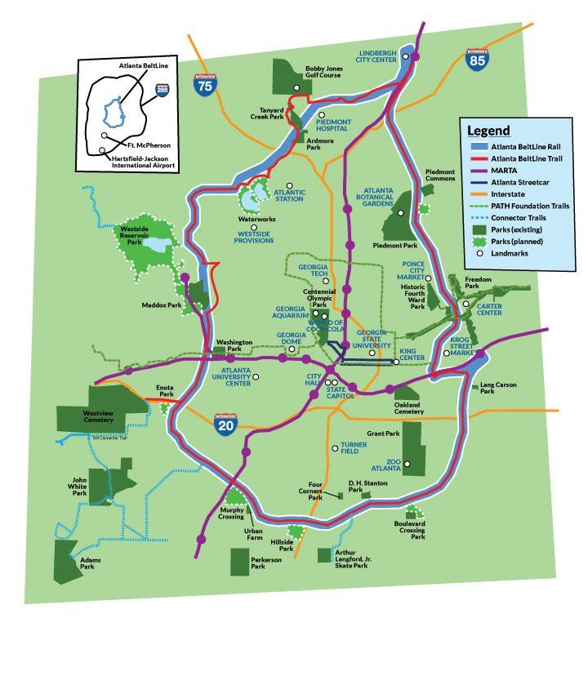
Atlanta beltline

Slide 8
Videos
Barcelona Super Blocks: https://www.youtube.com/watch?v=ZORzsubQA_M
The real reason streetcars are making a comeback: https://www.youtube.com/watch?v=RftqoygXXHk

