Slide 1
Get out colored pencils Periphery: urban models and issues hw: pgs. 443-446
APRIL 13, 2018

Slide 2
Trends in ldc cities
3 stages
Before Colonization
Religious center
European Colonial Period
Colonial services
European influence
2 different cities
Independence

Slide 3
Latin American model

Slide 4
Griffin-Ford Latin American Model
CBD- central plaza
Concentric Zones of Housing
Each ring decreases in value
Spine of Elite Housing
Squatter Settlements in periphery
Zones of Disamenity

Slide 5
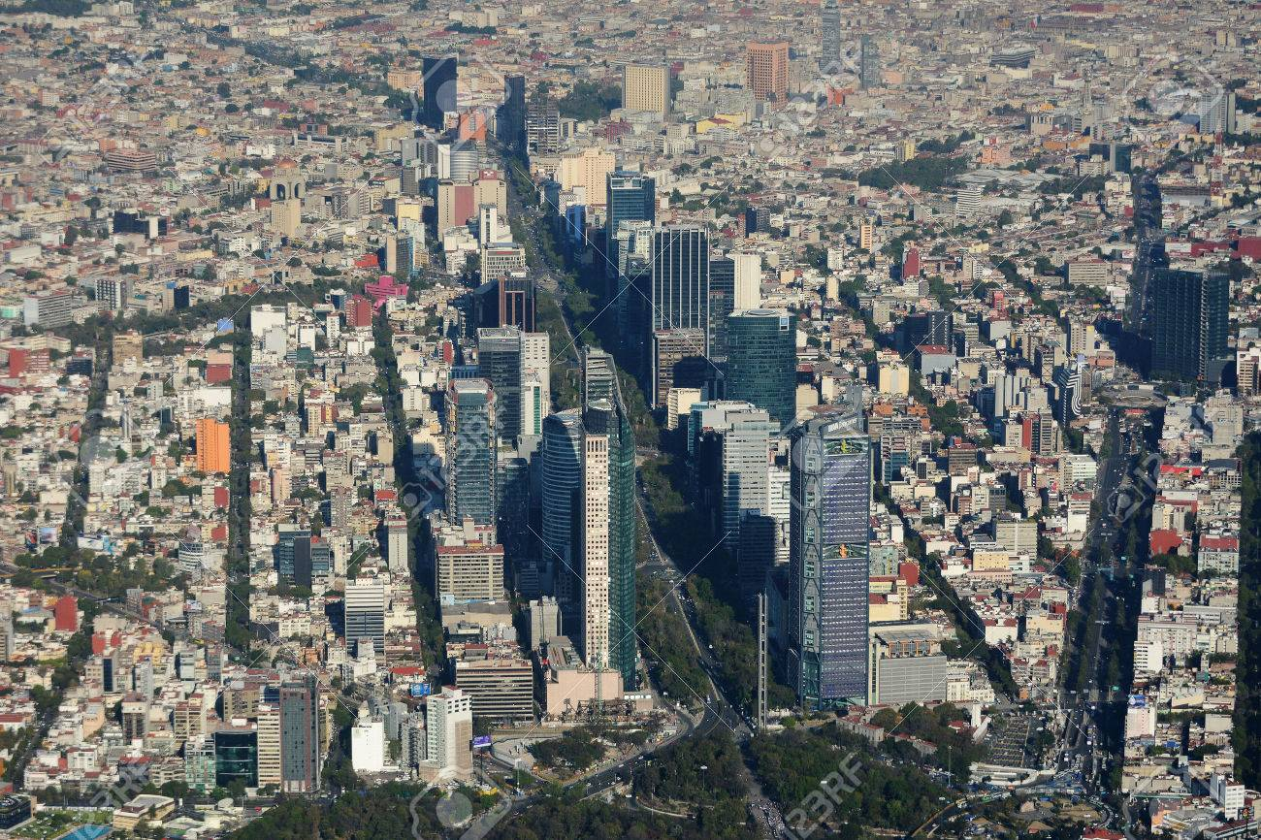
Central spine
Main boulevard
Business flanked by high class residential

Slide 6
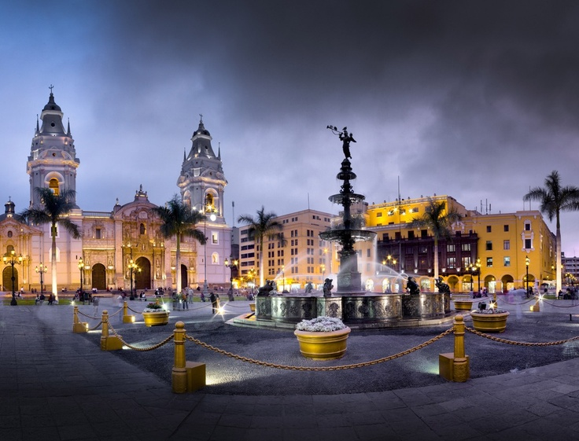
Central plaza
Focal point of city
Main plaza with a church
Govt. buildings
Central gathering area

Slide 7
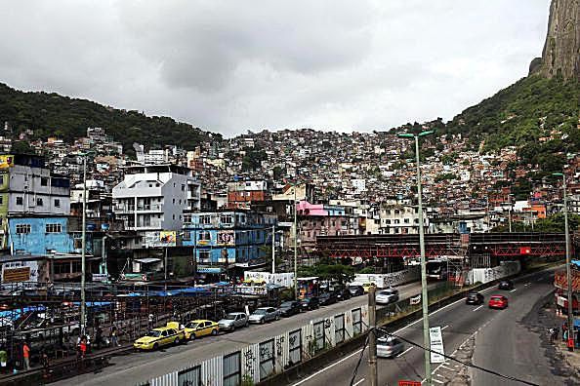
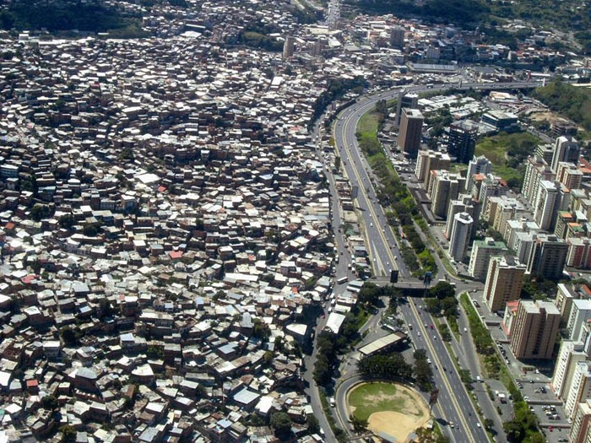
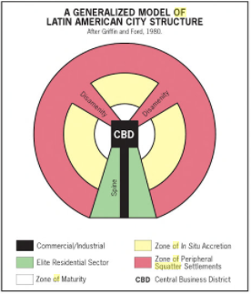
Zones of disamenity
Squatter Settlements
Illegal homes built on undesirable land
Hillsides, railroad tracks, river banks
Periphery of town
Self-constructed homes
No access to city services
Electricity, plumbing, sewage, trash collection, police, schools
Sometimes run by drug lords
Ex:
Favelas of Brazil
Shantytowns of South Africa
Bastee = India
Villas Misarias = Argentina
Colonias Letarias = Mexico

Slide 8
Videos
Inside Rio’s Favelas: https://www.youtube.com/watch?v=c3BRTlHFpBU
Where are the world’s worst slums?: https://www.youtube.com/watch?v=Q67gldZ1P_8

Slide 9
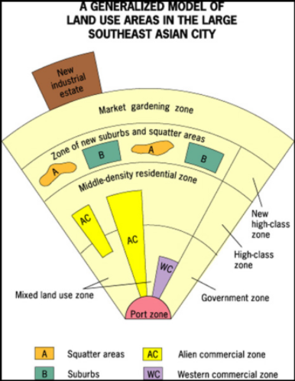
McGee SE Asian City Model
No significant CBD
Colonial Influence
Port
Western Commercial Zone
Special Economic Zones
Hybrid Sectors and Zones
New Industrial Parks on outskirts
Ex: Kuala Lumpur, Malaysia
Entrepots
Ex: Singapore

Slide 10
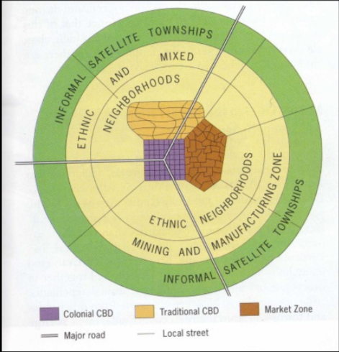
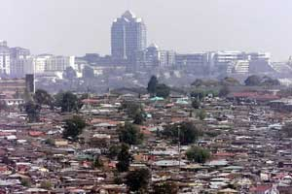
De blij sub-Saharan model
European Colonial Influence
Colonial CBD
Traditional CBD
Market CBD
Squatter settlements
Least urbanized region in the world, but fastest growing

Slide 11
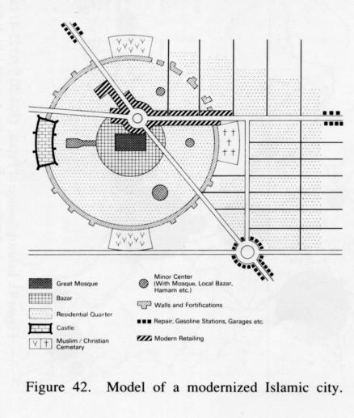
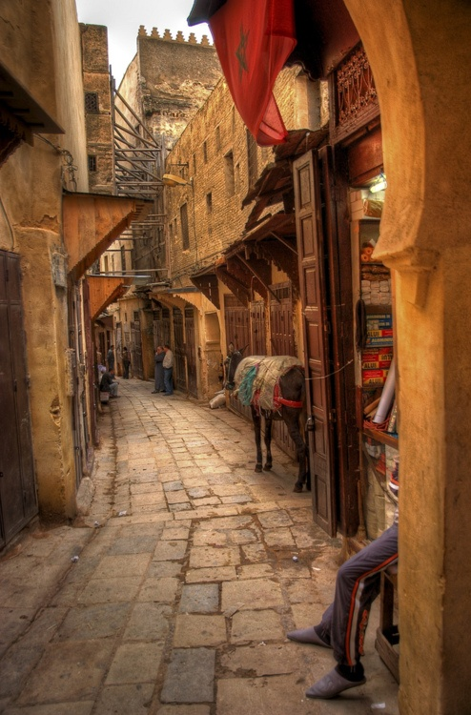
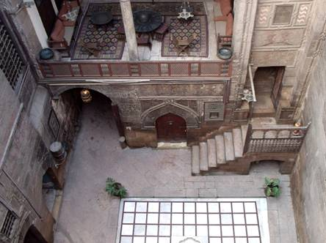
Islamic city model
Mosque at center
Bazaar surrounding it
Small winding streets
Homes with courtyards
Islamic tradition
Desert climate

